Slide 1
See separate .xls file
Table S1. Mean of B. cinerea lesion size of all isolates across all tomato accessions.

Slide 2
See separate .xls file
Table S2. Gene and Function Annotation from B05.10 and T4 GWA Results
a) Genes with significant SNPs on at least two tomato accessions by both bigRR on T4 and GEMMA on B05.10.
b) Genes with significant SNPs linked to Botrytis virulence response to tomato domestication by both bigRR on T4 and GEMMA on B05.10.
c) Functional categories significantly overrepresented in genes linked to Botrytis virulence response to tomato by both bigRR on T4 and GEMMA on B05.10.
d) Functional categories significantly overrepresented in genes linked to Botrytis virulence response to tomato domestication by both bigRR on T4 and GEMMA on B05.10.
e) Genes with significant SNPs from bigRR on T4 for Botrytis virulence in 11 or 12 of the tomato accessions.
f) Functional categories significantly overrepresented in genes linked to Botrytis virulence response to tomato domestication by bigRR on T4 alone.

Slide 4
Figure S1. Genetic distance between selected tomato accessions. Pairwise Euclidean distances between 426 wild and domesticated tomato accessions in the SolCAP diversity panel calculated from Infinium SNP genotyping at 7,720 loci (Sim 2012). Clustering is by R hclust's default UPGMA method. S. pimpinellifolium accessions in the current study are marked with orange stars, S. lycopersicum accessions in the current study are marked with blue stars. All of the wild S. pimpinellifolium included in this panel cluster with our 3 accessions. Mean ± SE of lesion size of B. cinerea across the full study is included for each accession.

Slide 5
Figure S2. Rank order plot of B. cinerea lesion size on two tomato genotypes.
Each B. cinerea isolate is a straight line tracing mean lesion size on LA1547 to mean on LA0410, the two host genotypes with the most pronounced effect on the rank order of isolates by lesion size (Wilcoxon signed-rank test with FDR-correction, p < 7.18e-17, Table S1).

Slide 6
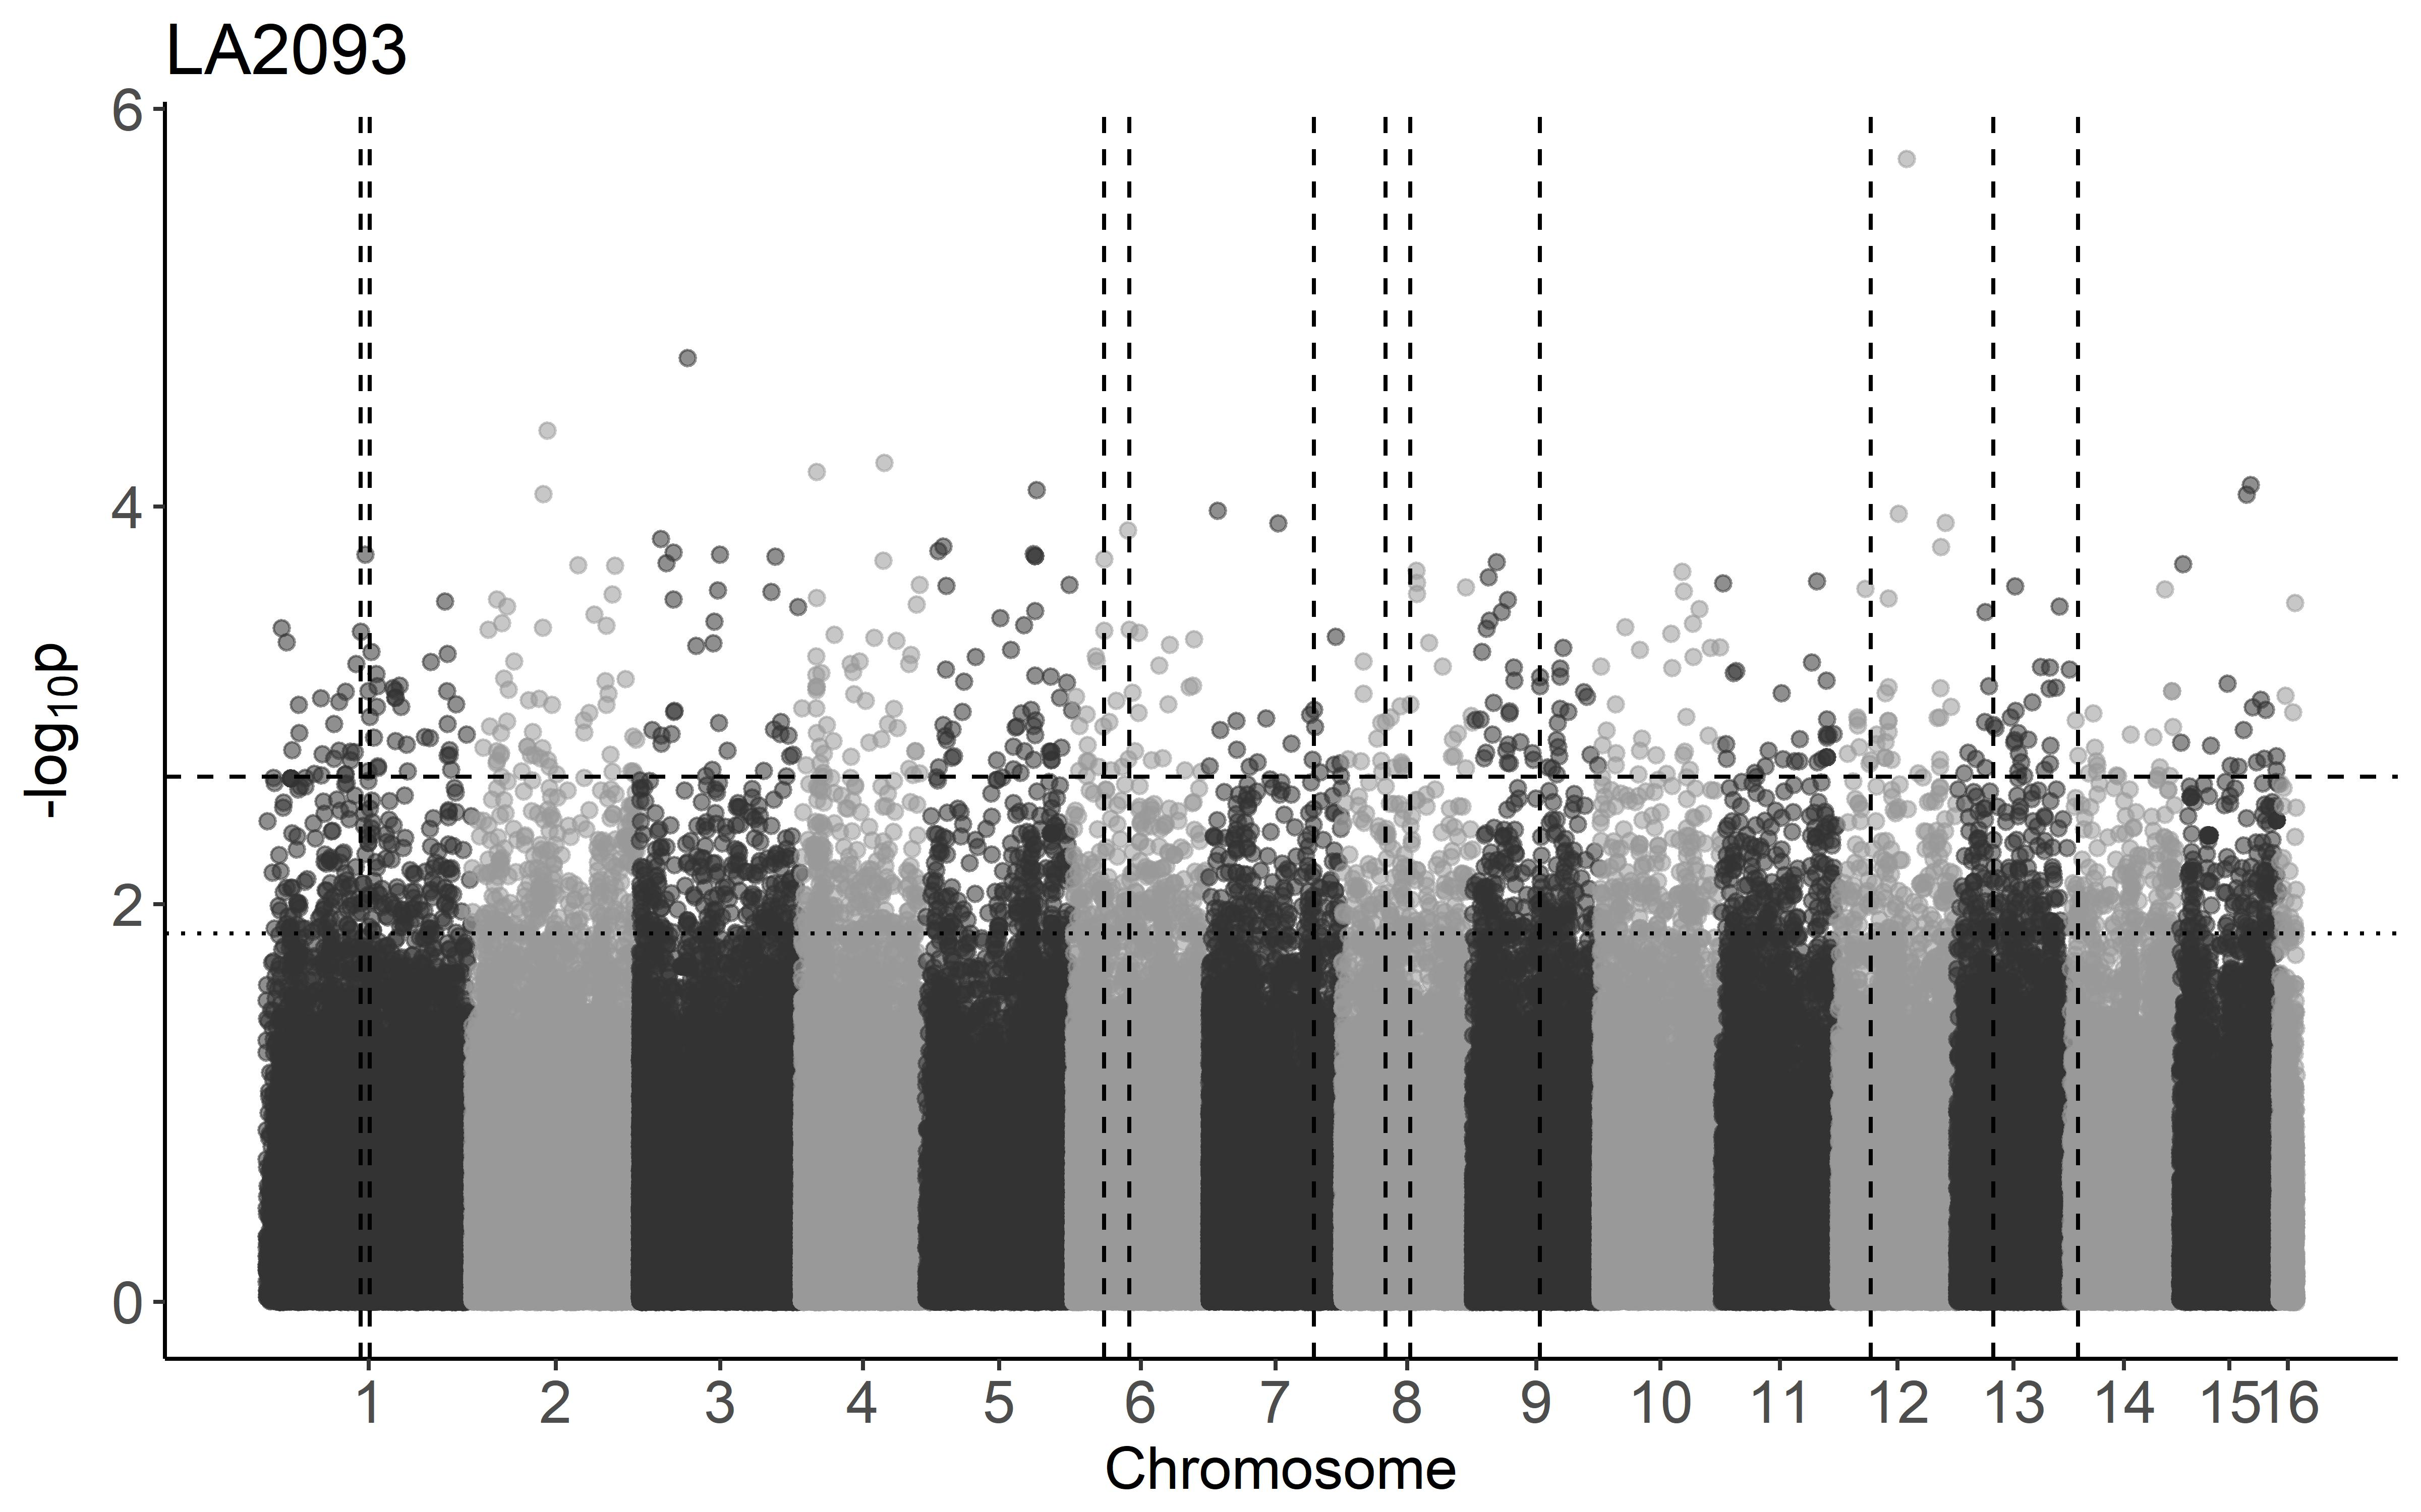
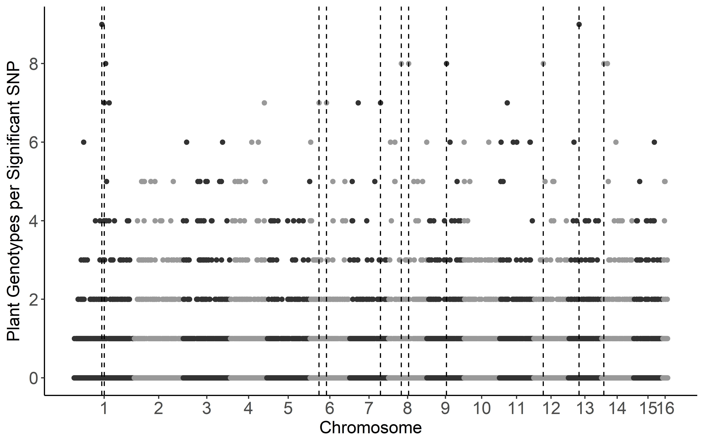
a)
b)

Slide 7
Figure S3. GWA by GEMMA of B. cinerea lesion size on individual tomato genotypes.
Botrytis cinerea chromosomes are differentiated by shading, alternating light and dark grey.
a) Manhattan plot of estimated SNP effect sizes for B. cinerea lesion size using a single tomato accession, LA2093. The 99% permutation threshold for SNP significance is shown with a dotted line, the 99.9% threshold is a dashed line.
b) The number of tomato accessions for which a B. cinerea SNP was significantly linked to lesion development using the 99.9% permutation threshold. Frequency is number of phenotypes in which the SNP is significant. Vertical dotted lines identify regions with overlap between the significant SNPs for LA2093 and significance across most (≥10) of tomato genotypes tested.

Slide 8
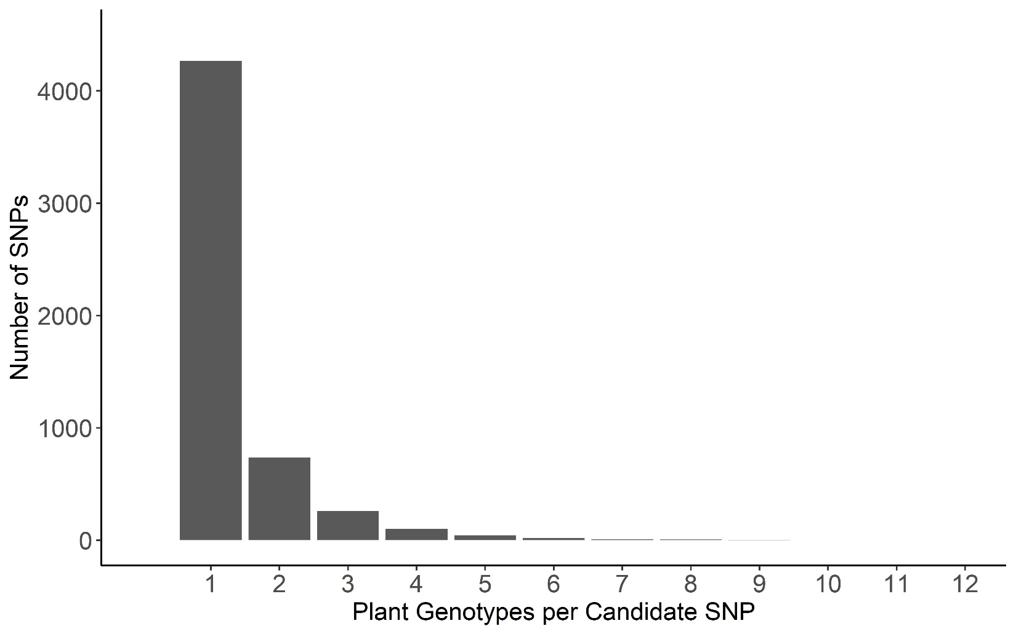
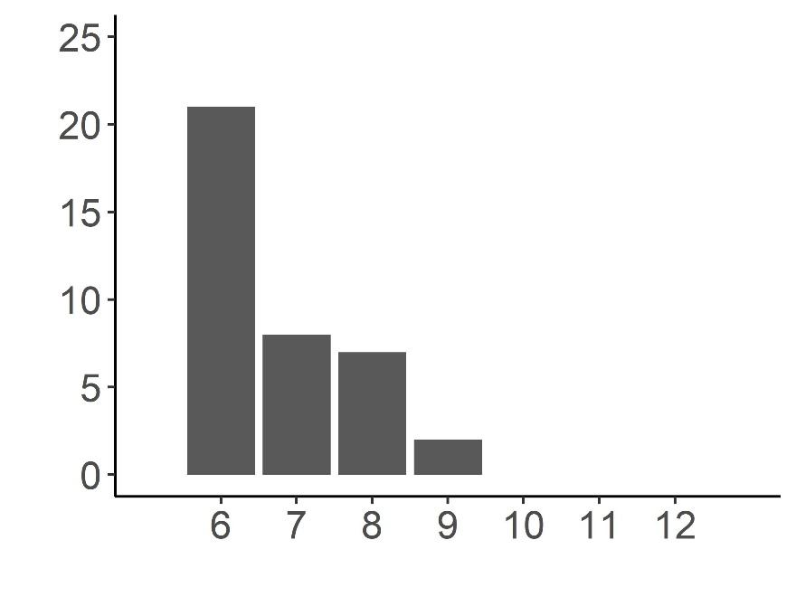
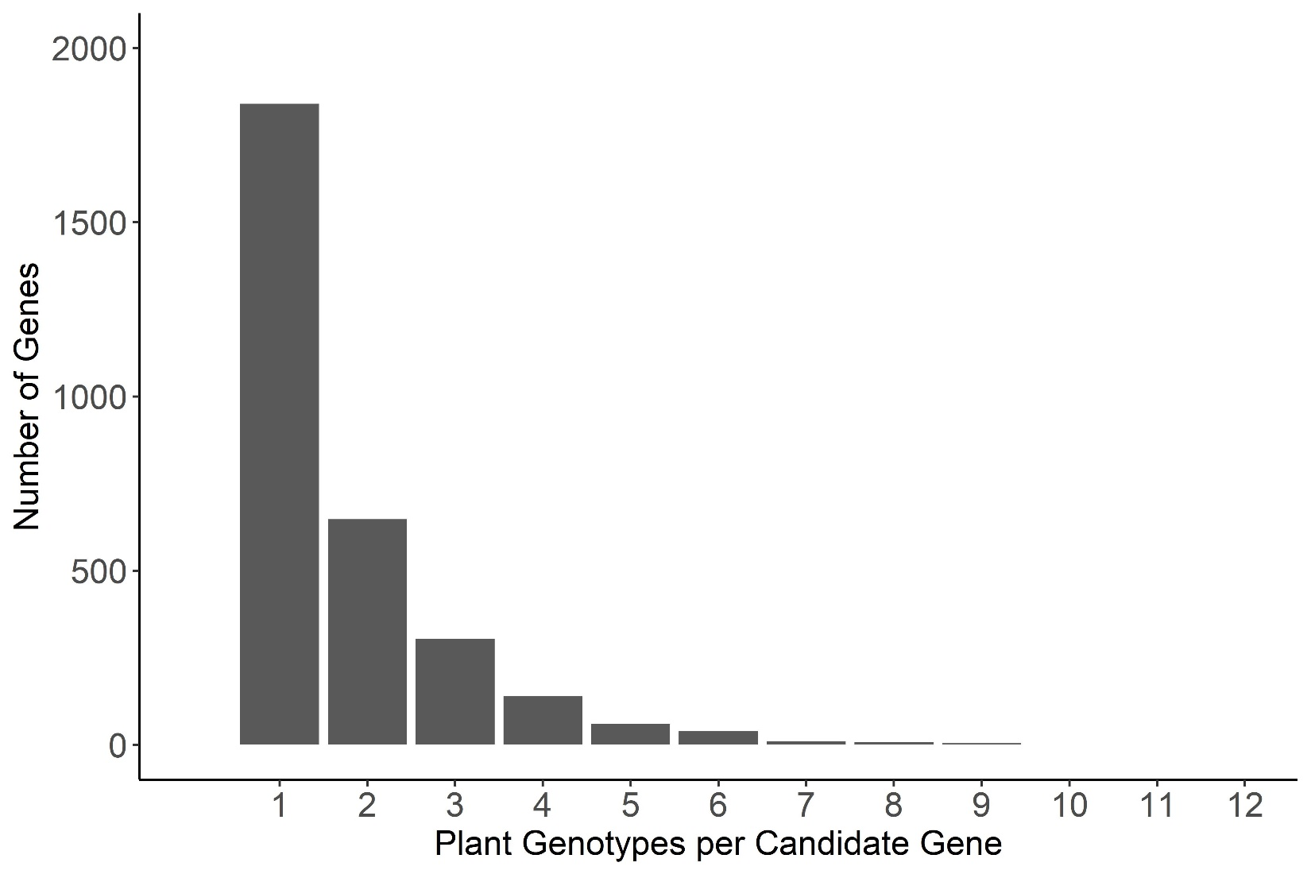
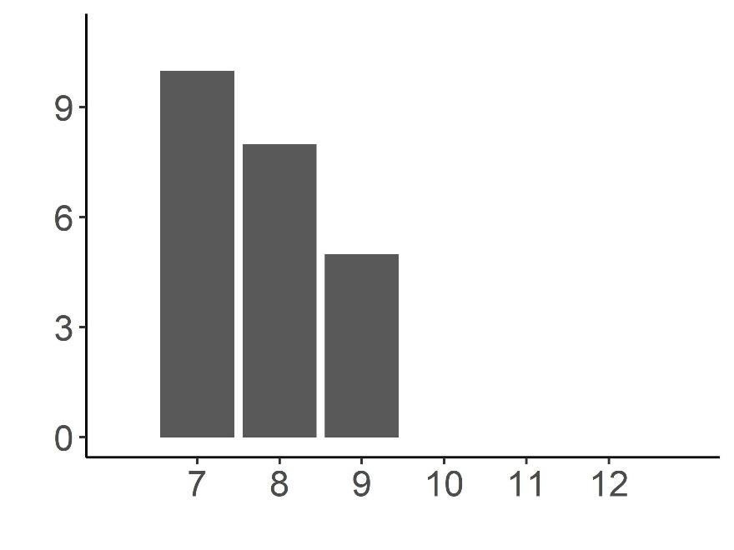
a)
b)

Slide 9
Figure S4. Frequency of overlap in B. cinerea GEMMA GWA significance across tomato accessions.
Frequency with which the top 1000 B. cinerea SNPs per phenotype significantly associated with lesion size on the 12 tomato accessions using the 99.9% permutation threshold.
Frequency with which a B. cinerea gene significantly associated with lesion size on the 12 tomato accessions. Genes were called as significant if there was one of the top 1000 significant SNPs per phenotype at the 99.9% permutation threshold within the gene body, or within 2kb of the gene body.

Slide 10
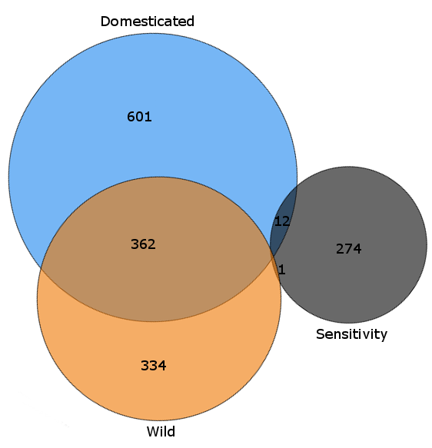
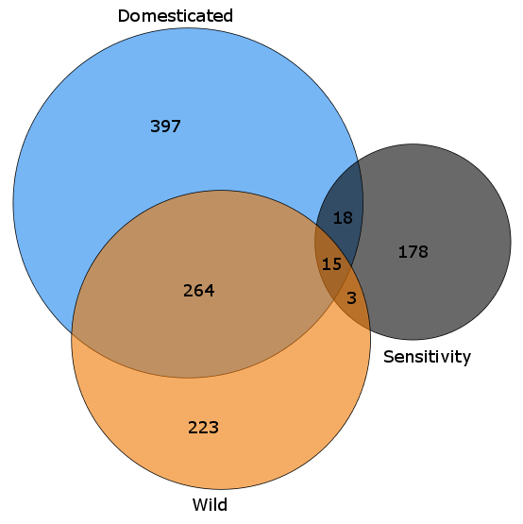
a)
b)

Slide 11
Figure S5. GEMMA GWA analysis of domestication sensitivity in B. cinerea.
Domestication sensitivity of each isolate was estimated using the average virulence on the wild and domesticated tomato germplasm and using calculated Sensitivity. This was then utilized for GWA mapping by GEMMA.
a) Venn diagram of overlapping SNPs identified as crossing the 99.9% permutation threshold for each trait.
b) Venn diagram of overlapping genes identified as crossing the 99.9% permutation threshold for each trait. Genes were called as significant if there was one significant SNP within the gene body or within 2kb of the gene body.

